Slide 1
Estimating Content Concreteness for Finding Comprehensible Documents
Date: 2013/8/27
Author: Shinya Tanaka, Adam Jatowt,
Makoto P. Kato, Katsumi Tanaka
Source: WSDM’13
Advisor: Jia-ling Koh
Speaker: Chen-Yu Huang

Slide 2
Outline
Introduction
Measurement of concreteness
Term
document
Evaluation the level
Term
document
Conclusion

Slide 3
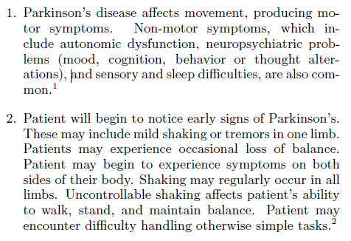
Introduction
Parkinson’s disease
Which one is easier to read ?
Concrete word
Notes:
This paper do

Slide 4
Introduction
Relevant web pages are of little utility if they are incomprehensible or impose too much cognitive burden on reader.
Document comprehensibility depends on many factors, of which concreteness and the ease of concept visualization are crucial ones.
Propose a method for predicting the concreteness of terms using SVM regression, and extend it to calculating document concreteness level.
Notes:
Difficult query

Slide 5
Outline
Introduction
Measurement of concreteness
Term
document
Evaluation the level
Term
document
Conclusion

Slide 6
Estimating concreteness of terms
Intuitive approach:
A topic-based by assuming that common terms in documents
Not all documents and terms in abstract domains are actually abstract
Follow a non-topical approach:
Select 21 features grouped in 8 categories
Notes:
definition

Slide 7
Estimating concreteness of terms
Visual Representativeness and Popularity
Imageability of terms indicates how easily and quickly people can imagine the referent of terms.
Hypothesis : words used frequently to describe photos or images have high probability to be concrete
Assumption : in most of the cases photos or images are annotated with terms that represent the displayed objects
Notes:
definition

Slide 8
Estimating concreteness of terms
Visual Representativeness and Popularity
Measure the popularity of using a given word to annotate photos, represent the features :
Freqweb(t) : the frequency of a term t in the Bing web search
Freqimage(t) : the frequency of a term t in
Freqphoto(t) : the frequency of a term t in Flickr
Normalized Freqimage(t) and Freqphoto(t), the additional features
Notes:
definition

Slide 9
Estimating concreteness of terms
Diversity of Annotations
Hypothesis : when many diverse annotations are added for photos related to a given term t, the term might be abstract
EX : happiness
Image of a smiling child playing with dog
Image of a couple walking together
Used social tagging data derived from Flickr to capturing the measure.
Describe the number of annotations which are added for contents related to a term t.
Notes:
definition

Slide 10
Estimating concreteness of terms
Diversity of Annotations
500 top ranked photos from the search result of term t
If there is another photo submitted by the same user that has identical tag set, the photo is skipped.
Photos(t) = { photo1, photo2, ….photon}
Features
Tags(t):the number of tags of photos in Photos(t)
Tagsuniq(t): the number of unique tags
Annotationsuniq(t):the corresponding number of unique annotations
Notes:
definition

Slide 11
Estimating concreteness of terms
Co-occurrence with Sense Verbs
Concreteness is defined in terms of perceivability.
Perceivability : the ability to sense the object
Concrete terms commonly occur with verbs which denote senses.
EX: see, hear
Use verbs to represent 5 basic senses : sight, hearing, taste, smell and touch
Notes:
definition

Slide 12
Estimating concreteness of terms
Co-occurrence with Sense Verbs
Using the window size of a single sentence
Ex: sight =>Verbssight = {see, sees, saw, seen}
The co-occurrence between a term t and verbs
Feature
*: matches more than 0 terms or does not match any terms in the same sentence
Notes:
definition

Slide 13
Estimating concreteness of terms
Number of Senses
A term often has more than on meaning
Hypothesis : when the number of senses of a term t is high, t might be abstract
Feature : the number of senses of term t
Notes:
definition

Slide 14
Estimating concreteness of terms
Depth in Ontology Tree
Concreteness of terms and their depth in an ontology tree have relational
Feature
EX : plant(4 senses)
Depths : 7, 5, 9, 11
Depthfreq(plant) = 11
Depthavg(plant) = 8
Depthfreq(t) : the depth of the most frequently
used sense of a term t
Depthavg(t):the average depth of the senses
of a term t
Notes:
definition

Slide 15
Estimating concreteness of terms
Number of Hyponyms
The number of hyponyms a term has appears to be related to the level of its generality
Hypothesis : when the number of hyponyms which a term t has is large, t might be abstract
Feature
Hyponymsfreq(t) : the number of hyponyms of the most frequently used sense of a term t
Hyponymsavg(t):the average number of all the senses of a term t
Notes:
definition

Slide 16
Estimating concreteness of terms
Sentiment Level
Intuitively, abstract terms tends to arouse positive or negative sentiments
EX : opportunity , regret v.s tree, road
Define the positivity, negativity, objectivity values of the most frequently used sense of a term t
Notes:
definition

Slide 17
Estimating concreteness of terms
Term Length
In English, many abstract nouns are formed by adding noun-forming suffixes to be adjectives, verbs, or other noun
EX : happiness , circulation
Hypothesis : the longer the number of characters in a term, the more abstract the term might be
Feature : the number of characters of a term t
Notes:
definition

Slide 18
Estimating concreteness of document
Average concreteness
Maximum concreteness
Assumption : document consist of abstract paragraph and concrete paragraph
D = {P1, P2….PL} Pi : a paragraph in D
Notes:
definition

Slide 19
Outline
Introduction
Measurement of concreteness
Term
document
Evaluation the level
Term
document
Conclusion

Slide 20
Evaluation of term-level
Concreteness terms can be represented by two psycholinguistic attributes : perceivability, imageability
Dataset
Medical Research Council Psycholinguistic Database(MRCDB)
150837 terms
Have the perceivability rating and imageability rating :3455 nouns
Knowledge base
WordNet
Flickr
SentiWordNet
Notes:
definition

Slide 21
Evaluation of term-level
The concreteness of term on MRCDB
PercMRC(t) : the perceivability rating of a term t in MRCDB
ImagMRC(t) : the imageability rating of t in MRCDB
Estimate the concreteness of a term t, ConcSVM(t) using perceivability ratings and imageability ratings estimated by SVM regression
Notes:
definition

Slide 22
Result
Three measurement
Pearson’s correlation coefficient
Kendall’s Τ
Root Mean Square
Notes:
definition

Slide 23
Feature selection
Finding the least effective feature in the set of all the features
Evaluate the importance of each feature with 5-fold cross-validation
Remove the feature step by step
Notes:
definition

Slide 24
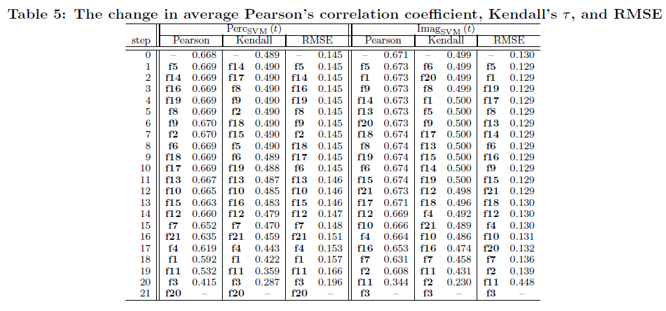
Feature selection
Notes:
definition

Slide 25
Term co-occurrence
Examined the relation between the co-occurrence of terms in the same sentences and their concreteness ratings as provided in MRCDB
Two sets of terms according to their perceivability or imageability score
Notes:
definition

Slide 26
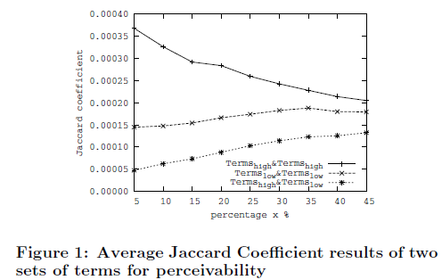
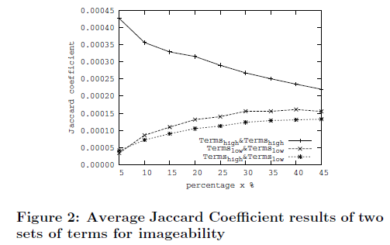
Term co-occurrence
Notes:
definition

Slide 27
Evaluation of document-level
Create dataset
50 queries : 35 abstract, 15 concrete
Top 10 returned search result
Remove HTML tags, Javascript, multimedia file
Extracted two top paragraphs
Notes:
definition

Slide 28
Result
Correlation between concreteness and comprehensibility
P(High Comp | High Conc) = 0.971
P(High Comp | Low Conc) = 0.491
P(High Conc | Low Comp) = 0.067
P(High Conc | High Comp) = 0.723
Notes:
definition

Slide 29
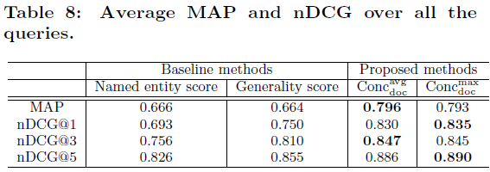
Result
Notes:
definition

Slide 30
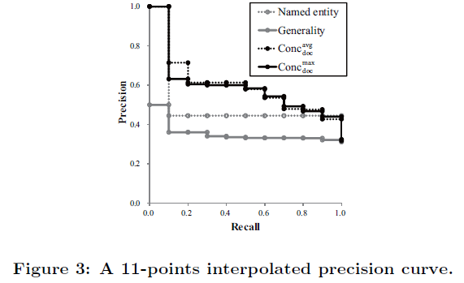
Result
It is relatively easy to determine the correct concreteness level for the document with plenty of concrete terms
Notes:
definition

Slide 31
Outline
Introduction
Measurement of concreteness
Term
document
Evaluation the level
Term
document
Conclusion

Slide 32
Conclusion
Describe method for evaluating the concreteness of words using machine learning and extrapolate it to the estimation of concreteness on the document-level.
In the future, would like to focus on the improvement as well as on the interplay between the concreteness and relevance of documents.
Notes:
definition

